Slide 1
TES Online Pay System (TOPS) Tutorial
2025

Slide 2
TES Employee Timesheets are available at http://tops.ucsd.edu/
Process:
Timesheets will be posted to TOPS typically by the Tuesday after a new pay period begins
Email notifications are sent to employee’s campus email once the new timesheet has been published
Employees log into TOPS, complete their timesheets, and submit them to their supervisors
Sign in using your ACTIVE DIRECTORY (campus email/associated password)
Timesheets must be submitted the Thursday before the pay period ends by 1:30 pm to ensure on-time payment
Email reminders to your campus email each pay period reminding you when the timesheet is due
When completing the biweekly timesheet, please include all anticipated working hours through the end of the pay period
There are times during the year that the deadline to complete timesheets are changed due to holidays. TESPayroll will notify employees regarding the deadline changes to their campus email. Please remember to review your campus emails at least 1-2 weekly.
For any corrections or if you miss submitting your timesheet by the deadline is missed, alert TESPayroll@ucsd.edu with a manual timesheet so we can assist with updating the timesheet on your behalf.
When emailing TESPayroll@ucsd.edu, please include your Reporting Supervisor as CC so they are aware of the changes. We also ask that employees list their name and employee id to help facilitate a timely response.

Slide 3
Important Note for TES Employees Placed in Health Assignments:
TES Employees will need to log into TOPS using their campus email address (@ucsd.edu) / campus Active Directory log-in
Email notifications from TOPS will only be sent to your campus email address that you received from TES
- NOT your “@health.ucsd.edu” email address

Slide 4
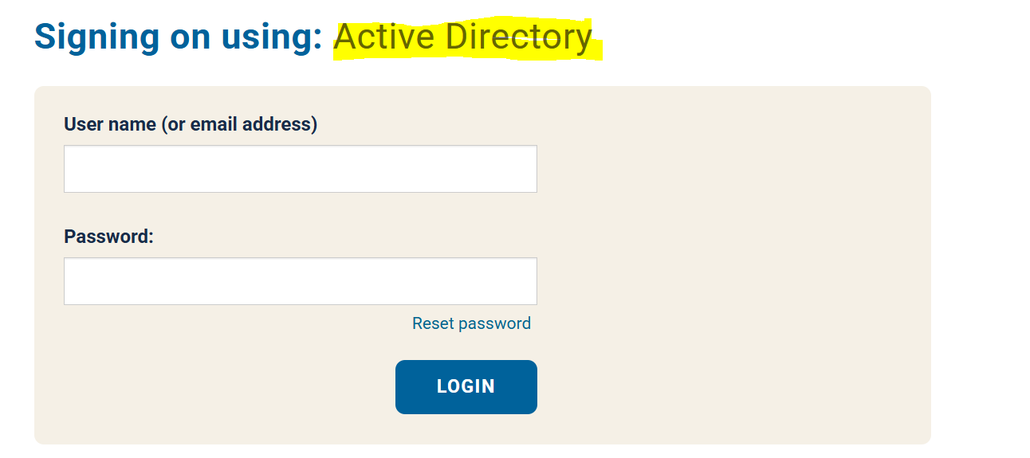
Logging into TOPS
Go to http://tops.ucsd.edu/
It will take you to the UCSD Log In Page:
Please sign on using your Active Directory Log in and follow system prompts to log in as part of the two step authentication process (DUO).

Slide 5
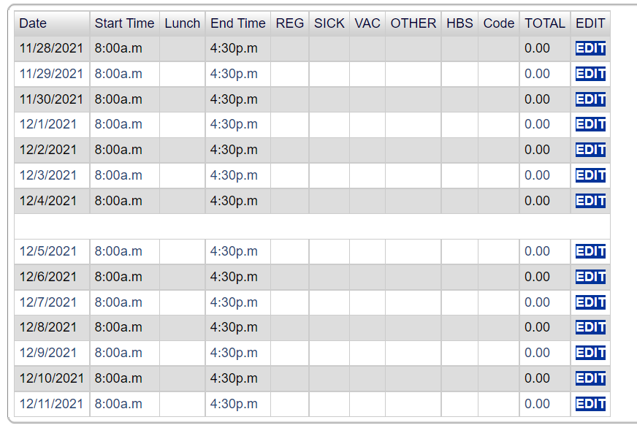
Submitting Hours
As soon as you log into TOPS, your timesheet for the current pay period should automatically appear.
If you log in and do not see your new timesheet, it has not been published yet.
You can view past timesheets that have already been processed under ‘Signed Timesheets’
Make sure it is the timesheet for the correct pay period you want to edit.
Your timesheet for the new pay period will be blank and look like the timesheet on the screen. --->
Click "EDIT" next to the day you want to update.

Slide 6
Submitting Worked Hours
The typical UC San Diego work schedule is 8:00 am to 4:30 pm with a 30 minute lunch period. Most TES employees’ schedules will look like the above. Meal breaks (30 minutes unpaid) are required for hourly employees working more than 6 hours in a day.
*Please note: If you work an alternate schedule, please be sure to enter in your exact start and end time with the correct lunch/break duration.
Enter the amount of hours you actually worked that day into the ‘Reg’ column
Once you have recorded your hours for that day, click ‘Record Hours’ and then continue onto the next days
You will need to click ‘Edit’ again on the next day

Slide 7
Submitting Vacation Hours
To input Vacation hours in your timesheet:
Enter your entire shift as normal, including the lunch break you would typically take
Then enter the amount of vacation hours you plan to take for that day into the ‘VAC’ column
If you took a half-day (worked half the day and then took vacation for the other half), it would look like the timesheet below:

Slide 8
Submitting Sick Hours
To input Sick hours in your timesheet:
Enter your entire shift as normal, including the lunch break you would typically take
Then enter the amount of sick hours you plan to take for that day into the ‘Sick’ column
Once you have recorded your hours for that day, click ‘Record Hours’ and then continue onto the next days

Slide 9
Submitting Hours for UC San Diego Interview
Employees can use up to 2 hours per pay period to interview for other UC San Diego positions
To enter time spent on a UC San Diego interview:
Enter your entire shift as normal, including the lunch break you would typically take
Then enter the amount of hours used to attend a UC San Diego interview into the ‘Other’ column
For ‘HBS Other Type’ choose ‘Interview’
In the "Comments:" box, enter:
Interview date
Job number
Name of interviewer
Then click "Record Comment"

Slide 10
Other Items to note
If you have any issues or questions with timekeeping, please contact TESPayroll@ucsd.edu. When contacting, please make sure to state your name and employee ID if available. It is helpful if you are specific and list important details so your request can be completed timely and cc your Reporting Supervisor.
If you are taking time off an not using vacation or sick leave, please add comments to the applicable timesheet for awareness and documentation purposes. ie: “I will be taking Monday through Friday off (1/21-1/24) and am choosing to take leave without pay”
Paystubs, w2s and accruals are accessed directly by employees by signing into UCPath with their Active Directory log in details (https://ucpath.ucsd.edu/)
View Paystubs: Employee Actions > Income and Taxes > View Paycheck
View Accruals: Employee Actions > Leave Balances Review
View W2: Employee Actions > Income and Taxes > View Online W-2/W-2C

Slide 11
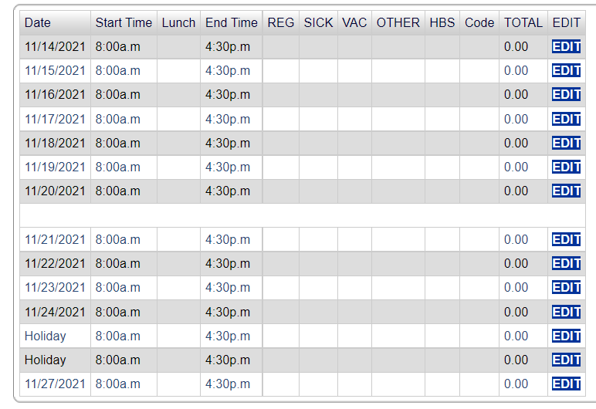
Holiday Hours
Paid University Holidays will already be indicated on your timesheet with “Holiday” instead of the date. For University Holidays:
DO NOT enter hours on the holiday day if you DID NOT WORK
ONLY enter hours if you WORKED on the holiday
If you worked on the holiday, please also note that in the ‘Comments’ section
Eligible Holiday pay is calculated by Central Payroll/UCPath once HR submits your timesheet
* You must be working at least 50% of the working hours in the 2 pay periods prior to the pay period of the holiday to qualify for holiday pay

Slide 12
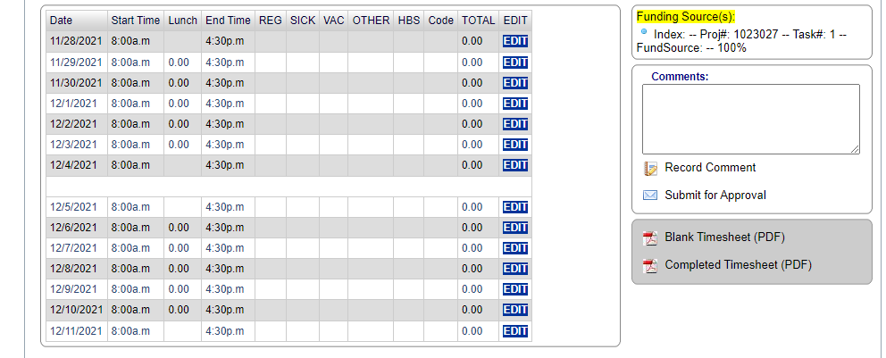
Submit Your Timesheet for Approval
Once you have completed filing out your timesheet:
Make sure you have edited all of the days you want for the time period.
Click on "Submit for Approval“
Please don’t forget to click on “Submit for Approval” as this will send an email alert to your Reporting Supervisor.
Your supervisor will be notified that your timesheet is ready for approval.
Once your supervisor approves your timesheet, you will get an email confirmation that it has been sent to HR.

Slide 13
Contacts
If you are having any issues logging into TOPS, accessing your timesheet, or have any questions, please reach out to the TES Payroll team at TESPayroll@ucsd.edu.
If you do not have a timesheet published by the Wednesday before your timesheet is due, please be sure to fill out the Manual Timesheet and submit it to Tespayroll@ucsd.edu as soon as possible.
If your supervisor will not be available to approve your timesheet, inform the TES Payroll Team by emailing TESPayroll@ucsd.edu.

